Slide 1
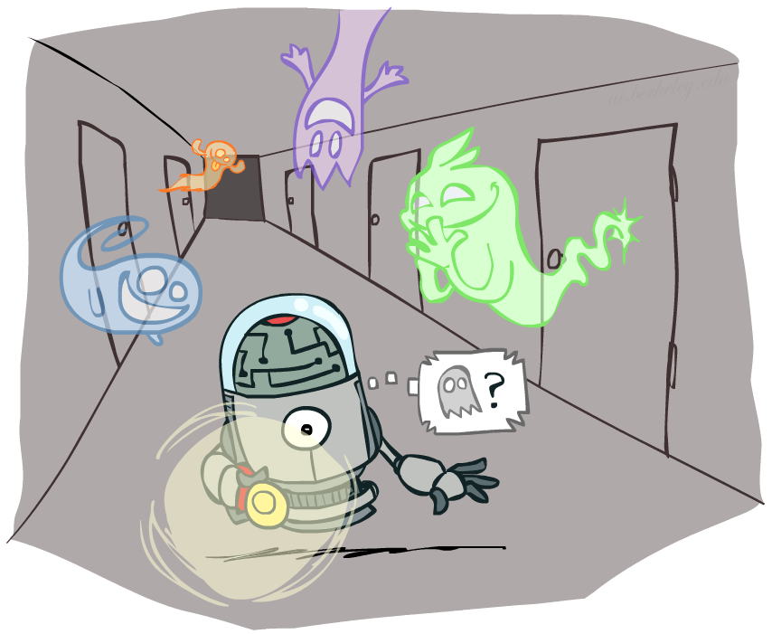
Artificial Intelligence
Filtering
[These slides were created by Dan Klein, Pieter Abbeel, and Anca. http://ai.berkeley.edu.]
Notes:
Please retain proper attribution, including the reference to ai.berkeley.edu. Thanks!

Slide 2
Filtering / Monitoring
Filtering, or monitoring, is the task of tracking the distribution B_{t}(X) = P_{t}(X_{t} | e₁, …, e_{t}) (the belief state) over time
We start with B₁(X) in an initial setting, usually uniform
As time passes, or we get observations, we update B(X)
The Kalman filter was invented in the 60’s and first implemented as a method of trajectory estimation for the Apollo program
Notes:
Dan has some demo for this

Slide 3
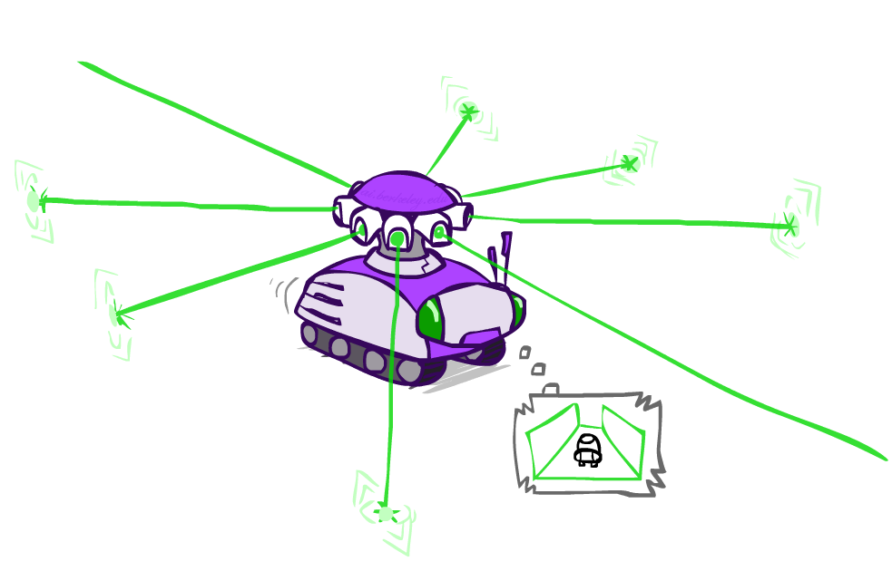
Example: Robot Localization
Example from Michael Pfeiffer
Prob
0
1
t=0
Sensor model: can read in which directions there is a wall, never more than 1 mistake
Motion model: may not execute action with small prob.

Slide 4
Example: Robot Localization
Prob
0
1
t=1
Lighter grey: was possible to get the reading, but less likely b/c required 1 mistake

Slide 5
Example: Robot Localization
Prob
0
1
t=2

Slide 6
Example: Robot Localization
Prob
0
1
t=3

Slide 7
Example: Robot Localization
Prob
0
1
t=4

Slide 8
Example: Robot Localization
Prob
0
1
t=5

Slide 9
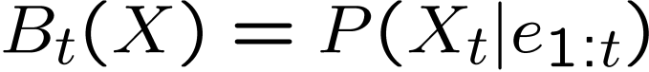
Inference: Find State Given Evidence
We are given evidence at each time and want to know
Idea: start with P(X₁) and derive B_{t} in terms of B_{t-1}
equivalently, derive B_{t+1} in terms of B_{t}

Slide 10
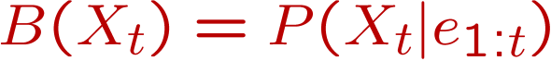
Two Steps: Passage of Time + Observation
X₁
X₂
X₃
X₄
X₅
E₁
E₂
E₃
E₄
E₅

Slide 11
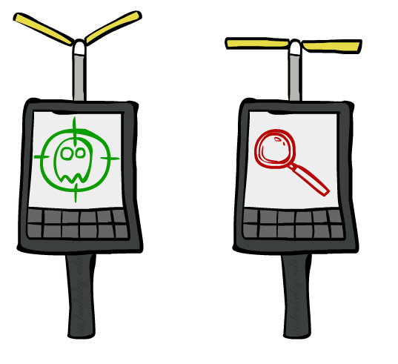

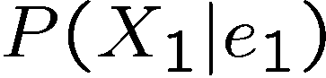
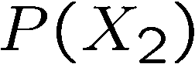
Inference: Base Cases
X₁
X₁
X₂
E₁

Slide 12
Passage of Time
Assume we have current belief P(X | evidence to date)
Then, after one time step passes:
Basic idea: beliefs get “pushed” through the transitions
With the “B” notation, we have to be careful about what time step t the belief is about, and what evidence it includes
X₁
X₂
Or compactly:
Notes:
TODO: intermediate step in derivation!

Slide 13

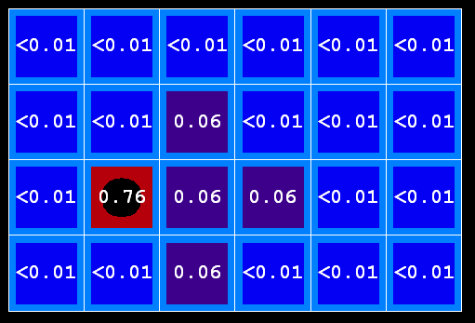
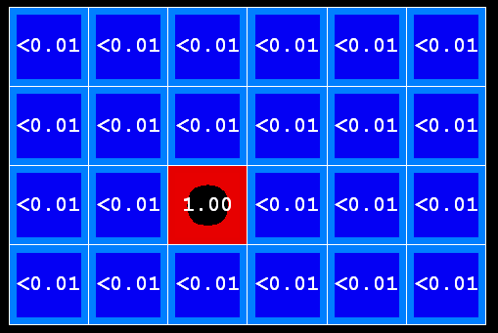
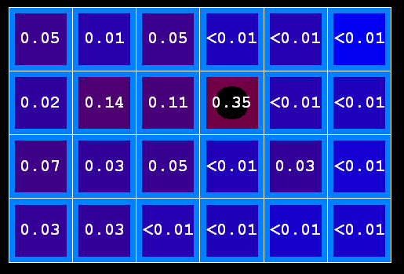
Example: Passage of Time
As time passes, uncertainty “accumulates”
(Transition model: ghosts usually go clockwise)
T = 1
T = 2
T = 5

Slide 14
Observation
X₁
Assume we have current belief P(X | previous evidence):
Then, after evidence comes in:
Or, compactly:
E₁
Basic idea: beliefs “reweighted” by likelihood of evidence
Unlike passage of time, we have to renormalize
Notes:
Basic idea: beliefs “reweighted” by likelihood of evidence
Unlike passage of time, we have to renormalize

Slide 15


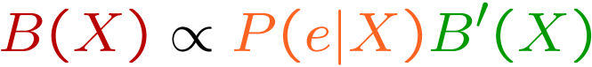
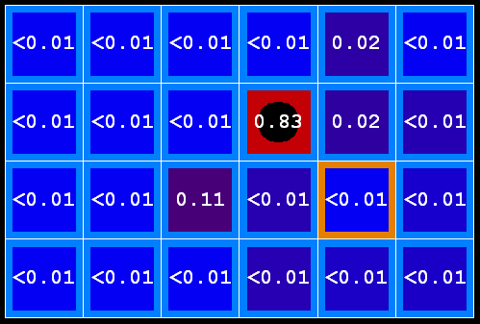
Example: Observation
As we get observations, beliefs get reweighted, uncertainty “decreases”
Before observation
After observation

Slide 16

Example: Weather HMM
B’(+r) = 0.5
B’(-r) = 0.5
B’(+r) = 0.627
B’(-r) = 0.373
B(+r) = 0.5
B(-r) = 0.5
B(+r) = 0.818
B(-r) = 0.182
B(+r) = 0.883
B(-r) = 0.117
Rain₀
Rain₁
Rain₂
Umbrella₁
Umbrella₂
Notes:
demo

Slide 17
Online Belief Updates
Every time step, we start with current P(X | evidence)
We update for time:
We update for evidence:
The forward algorithm does both at once (and doesn’t normalize)
X₁
X₂
X₂
E₂

Slide 18
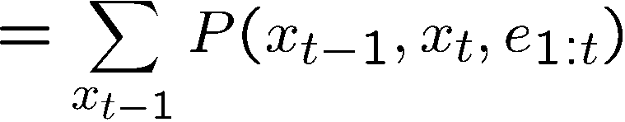
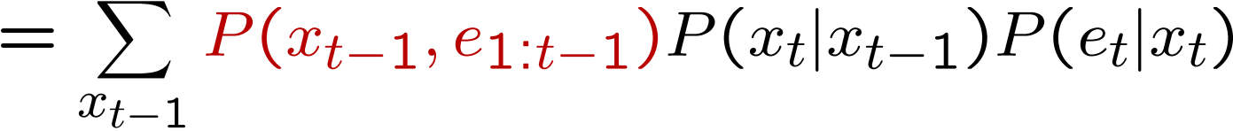
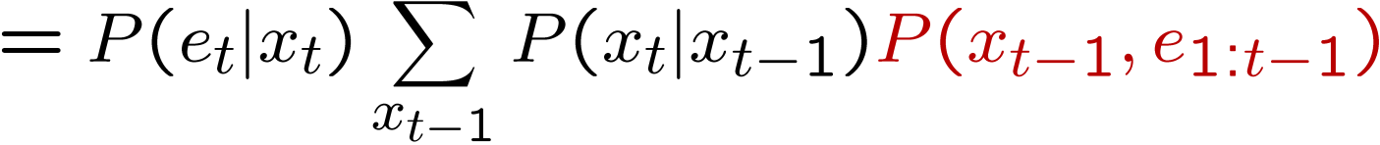
The Forward Algorithm
We are given evidence at each time and want to know
We can derive the following updates
We can normalize as we go if we want to have P(x|e) at each time step, or just once at the end…
t
[Demo: Ghostbusters Exact Filtering (L15D2)]
Notes:
TODO: explain propto and it’s X_t, not X

Slide 19
习题：假设有以下隐式马尔可夫模型。
假设我们已知O₁=A和O₂=B，
用前向算法求P(X₂| O₁=A, O₂=B).
用粒子滤波求P(X₂| O₁=A, O₂=B). 假设初始有2个粒子P₁=0，P₂=1，产生的随机数如下：
{ 0.22，0.05，0.33，0.20，0.84，0.54，0.79，0.66，0.14，0.96}
X₁
X₂
X_{t} | X_{t+1} | P(X_{t+1}|X_{t+1})
0 | 0 | 0.4
0 | 1 | 0.6
1 | 0 | 0.8
1 | 1 | 0.2
X_{t} | O_{t} | P(O_{t}|X_{t})
0 | A | 0.9
0 | B | 0.1
1 | A | 0.5
1 | B | 0.5
X₁ | P(X₁)
0 | 0.3
1 | 0.7
O₁
O₂

Slide 20
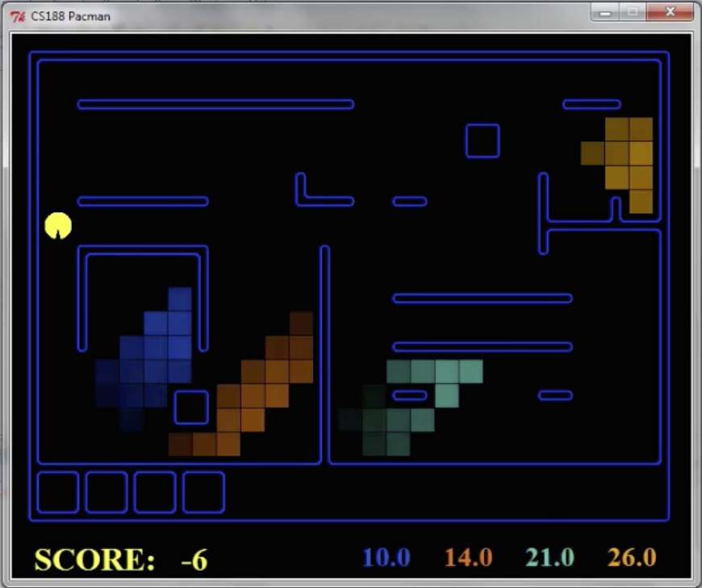
Pacman – Sonar
[Demo: Pacman – Sonar – No Beliefs(L14D1)]

Slide 21
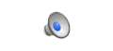
Video of Demo Pacman – Sonar (with beliefs)

Slide 22
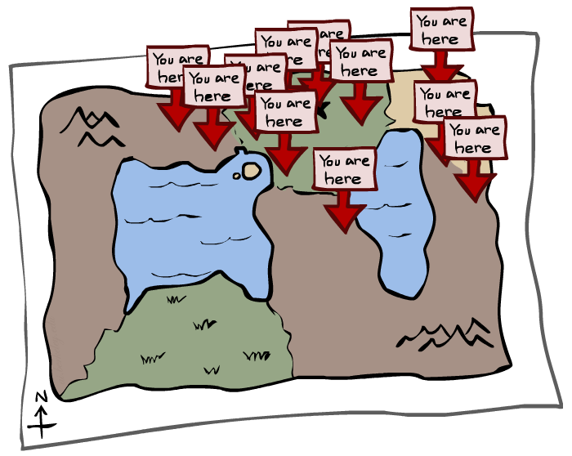
Particle Filtering

Slide 23
Particle Filtering
Filtering: approximate solution
Sometimes |X| is too big to use exact inference
|X| may be too big to even store B(X)
E.g. X is continuous
Solution: approximate inference
Track samples of X, not all values
Samples are called particles
Time per step is linear in the number of samples
But: number needed may be large
In memory: list of particles, not states
This is how robot localization works in practice
Particle is just new name for sample
0.0
0.1
0.0
0.0
0.0
0.2
0.0
0.2
0.5

Slide 24
Representation: Particles
Our representation of P(X) is now a list of N particles (samples)
Generally, N << |X|
Storing map from X to counts would defeat the point
P(x) approximated by number of particles with value x
So, many x may have P(x) = 0!
More particles, more accuracy
For now, all particles have a weight of 1
Particles:
(3,3)
(2,3)
(3,3)
(3,2)
(3,3)
(3,2)
(1,2)
(3,3)
(3,3)
(2,3)

Slide 25
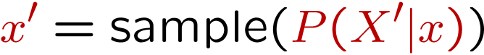
Particle Filtering: Elapse Time
Each particle is moved by sampling its next position from the transition model
This is like prior sampling – samples’ frequencies reflect the transition probabilities
Here, most samples move clockwise, but some move in another direction or stay in place
This captures the passage of time
If enough samples, close to exact values before and after (consistent)
Particles:
(3,3)
(2,3)
(3,3)
(3,2)
(3,3)
(3,2)
(1,2)
(3,3)
(3,3)
(2,3)
Particles:
(3,2)
(2,3)
(3,2)
(3,1)
(3,3)
(3,2)
(1,3)
(2,3)
(3,2)
(2,2)

Slide 26
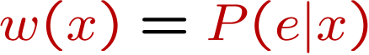
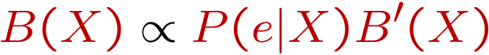
Particle Filtering: Observe
Particles:
(3,2)
(2,3)
(3,2)
(3,1)
(3,3)
(3,2)
(1,3)
(2,3)
(3,2)
(2,2)
Slightly trickier:
Don’t sample observation, fix it
Similar to likelihood weighting, downweight samples based on the evidence
As before, the probabilities don’t sum to one, since all have been downweighted (in fact they now sum to (N times) an approximation of P(e))
Particles:
(3,2) w=.9
(2,3) w=.2
(3,2) w=.9
(3,1) w=.4
(3,3) w=.4
(3,2) w=.9
(1,3) w=.1
(2,3) w=.2
(3,2) w=.9
(2,2) w=.4

Slide 27
Particle Filtering: Resample
Rather than tracking weighted samples, we resample
N times, we choose from our weighted sample distribution (i.e. draw with replacement)
This is equivalent to renormalizing the distribution
Now the update is complete for this time step, continue with the next one
Particles:
(3,2) w=.9
(2,3) w=.2
(3,2) w=.9
(3,1) w=.4
(3,3) w=.4
(3,2) w=.9
(1,3) w=.1
(2,3) w=.2
(3,2) w=.9
(2,2) w=.4
(New) Particles:
(3,2)
(2,2)
(3,2)
(2,3)
(3,3)
(3,2)
(1,3)
(2,3)
(3,2)
(3,2)

Slide 28
Recap: Particle Filtering
Particles: track samples of states rather than an explicit distribution
Elapse
Weight
Resample
Particles:
(3,3)
(2,3)
(3,3)
(3,2)
(3,3)
(3,2)
(1,2)
(3,3)
(3,3)
(2,3)
Particles:
(3,2)
(2,3)
(3,2)
(3,1)
(3,3)
(3,2)
(1,3)
(2,3)
(3,2)
(2,2)
Particles:
(3,2) w=.9
(2,3) w=.2
(3,2) w=.9
(3,1) w=.4
(3,3) w=.4
(3,2) w=.9
(1,3) w=.1
(2,3) w=.2
(3,2) w=.9
(2,2) w=.4
(New) Particles:
(3,2)
(2,2)
(3,2)
(2,3)
(3,3)
(3,2)
(1,3)
(2,3)
(3,2)
(3,2)
[Demos: ghostbusters particle filtering (L15D3,4,5)]

Slide 29
Video of Demo – Moderate Number of Particles

Slide 30
Video of Demo – One Particle

Slide 31
Video of Demo – Huge Number of Particles

Slide 32
习题：假设有以下隐式马尔可夫模型。
假设我们已知O₁=A和O₂=B，
用前向算法求P(X₂| O₁=A, O₂=B).
用粒子滤波求P(X₂| O₁=A, O₂=B). 假设初始有2个粒子P₁=0，P₂=1，产生的随机数如下：
{ 0.22，0.05，0.33，0.20，0.84，0.54，0.79，0.66，0.14，0.96}
X₁
X₂
X_{t} | X_{t+1} | P(X_{t+1}|X_{t+1})
0 | 0 | 0.4
0 | 1 | 0.6
1 | 0 | 0.8
1 | 1 | 0.2
X_{t} | O_{t} | P(O_{t}|X_{t})
0 | A | 0.9
0 | B | 0.1
1 | A | 0.5
1 | B | 0.5
X₁ | P(X₁)
0 | 0.3
1 | 0.7
O₁
O₂

Slide 33
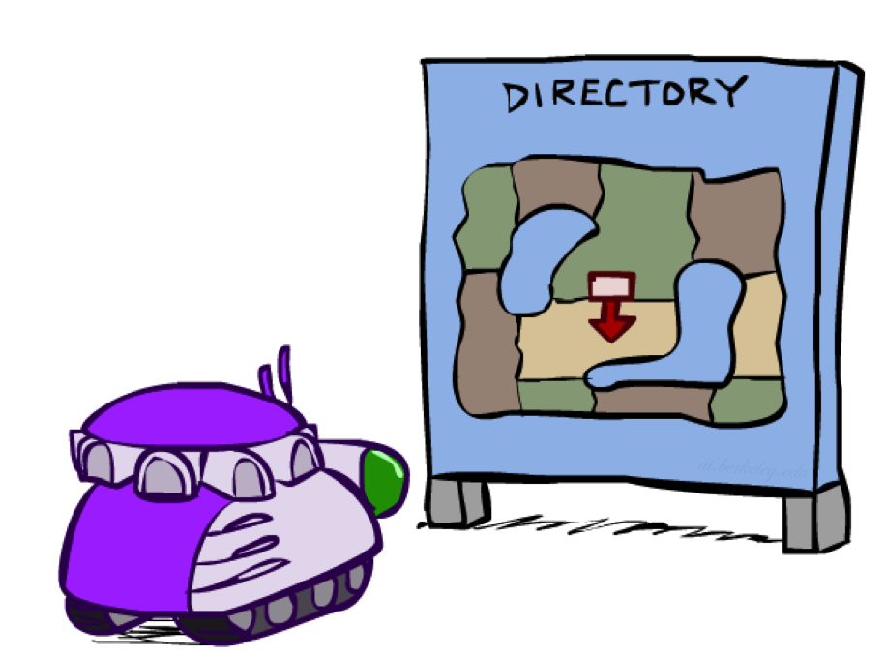
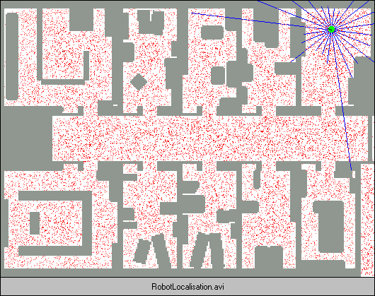
Robot Localization
In robot localization:
We know the map, but not the robot’s position
Observations may be vectors of range finder readings
State space and readings are typically continuous (works basically like a very fine grid) and so we cannot store B(X)
Particle filtering is a main technique

Slide 34

Particle Filter Localization (Sonar)
[Dieter Fox, et al.]
[Video: global-sonar-uw-annotated.avi]

